Slide 1
Unsupervised Semantic Segmentation by Distilling Features Correspondences
Paper review
Gibeom Kim (UST)

Slide 2
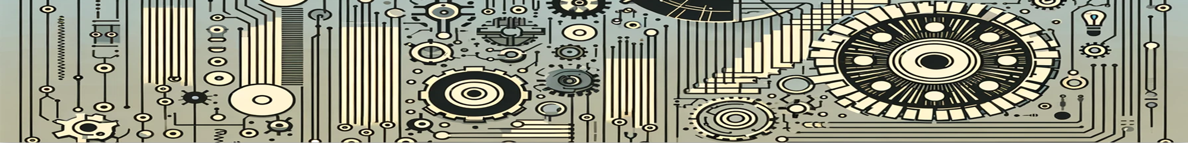
Index
Paper abstract
1-1. Optical flow
1-2. Correlation layer
1-3. correlation volume
Model
Conclusion

Slide 3
1. Paper abstract
Deep learning architecture for Unsupervised semantic segmentation
Extract feature from the images by using pretrained model, and transfer to segmentation head. Segmentation head
Also ambiguous set is clustered into two dataset.
During training, similar datasets are trained to produce similar outputs, while different snippets yield different outputs.

Slide 4
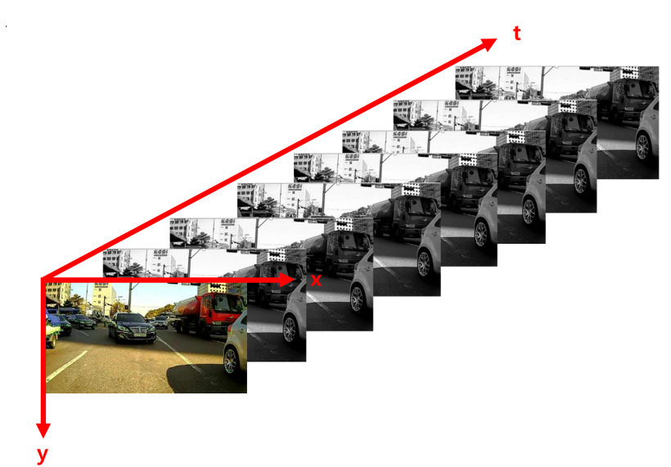
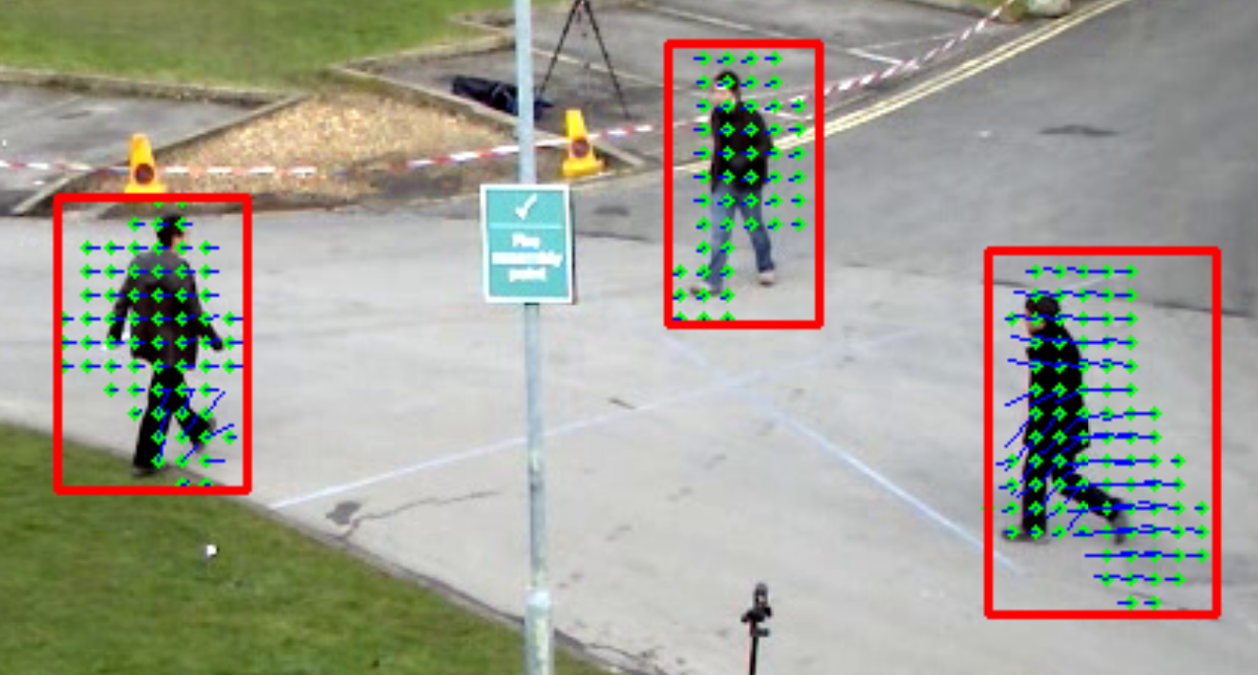
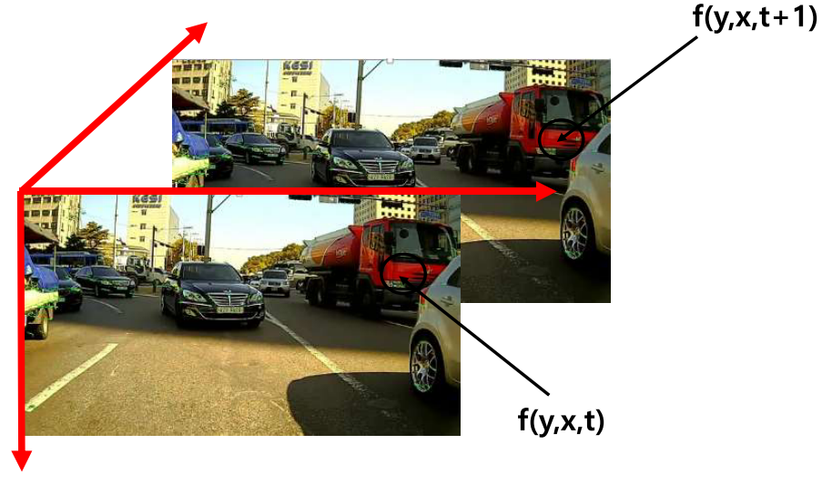
1-1. Optical flow

Slide 5
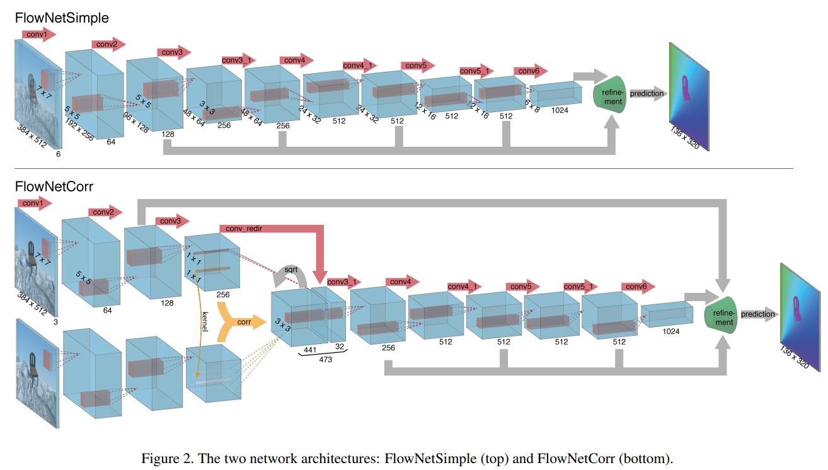
1-2. Correlation layer

Slide 6
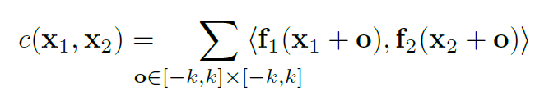
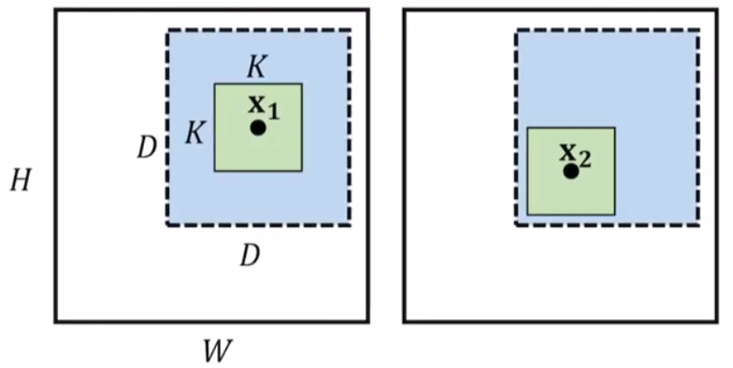
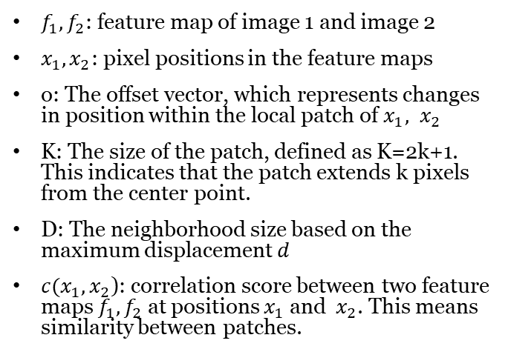
1-2. Correlation layer
$f_{1},f_{2}$: feature map of image 1 and image 2
$x_{1},x_{2}$: pixel positions in the feature maps
o: The offset vector, which represents changes in position within the local patch of $x_{1}, x_{2}$
K: The size of the patch, defined as K=2k+1. This indicates that the patch extends k pixels from the center point.
D: The neighborhood size based on the maximum displacement 𝑑
$c(x_{1},x_{2}$): correlation score between two feature maps $f_{1},f_{2}$ at positions $x_{1}$ and ​ $x_{2}$. This means similarity between patches.

Slide 7
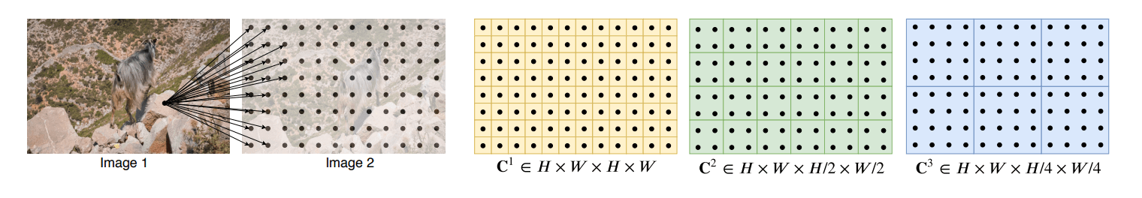
1-3. Correlation volume

Slide 8
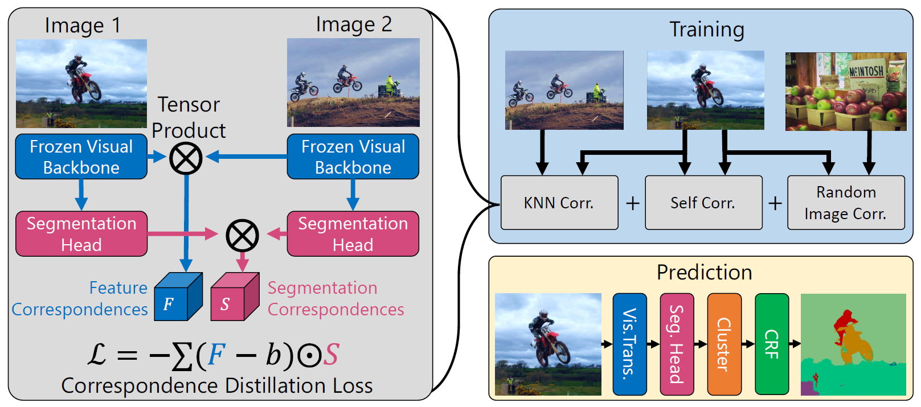
2. Model

Slide 9
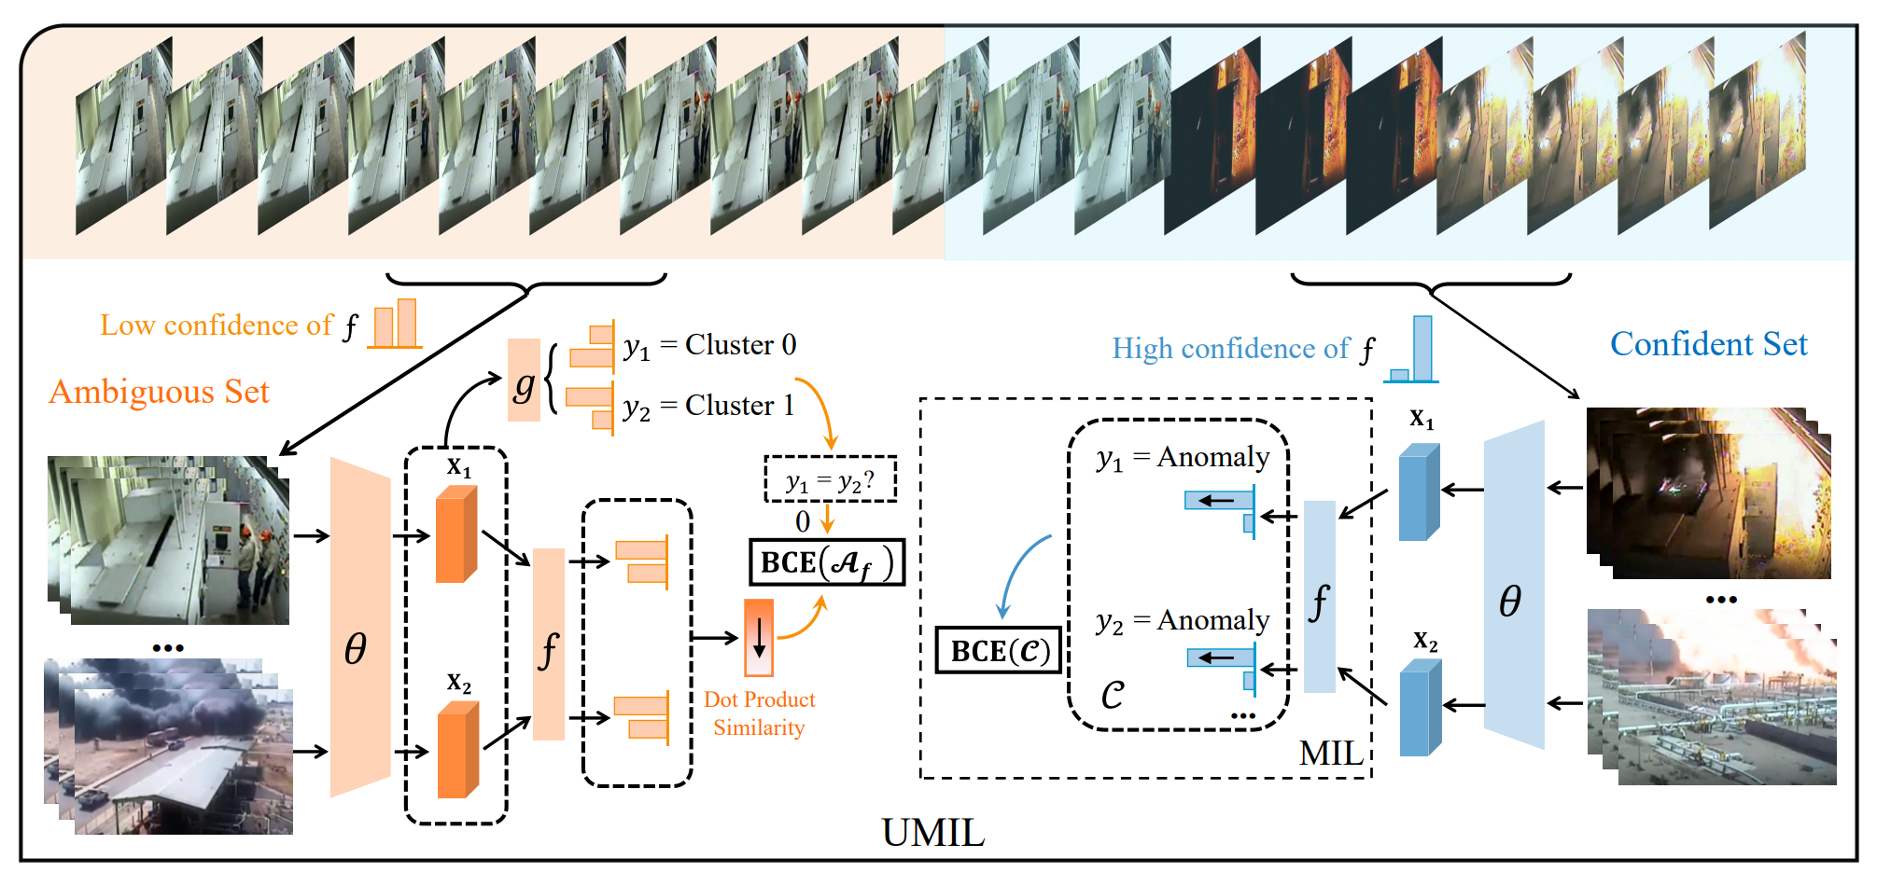
2. Model
Train with confidence set
Extract feature by using pretrained model(θ, e.g. X-CLIP)
Calculate the confidence of the snippets by using anomaly head
Update the model with binary cross entropy loss of confidence

Slide 10
2. Model
Train with ambiguous set
Divide snippets to two cluster by using cluster head g.
Extract feature by using pretrained model(θ, e.g. X-CLIP)
Calculate the confidence of the snippets by using anomaly head
Update the model with binary cross entropy loss of confidence
Notes:
데이터를 두개의 클러스터로 나누고 클러스터링 결과와 실제 레이블 간의 Binary Cross-Entropy를 계산
비디오 특징 벡터 간의 유사성을 기반으로 계산되며, 모델이 서로 유사한 비디오 특징을 유사한 방식으로 처리하도록 계산

Slide 11
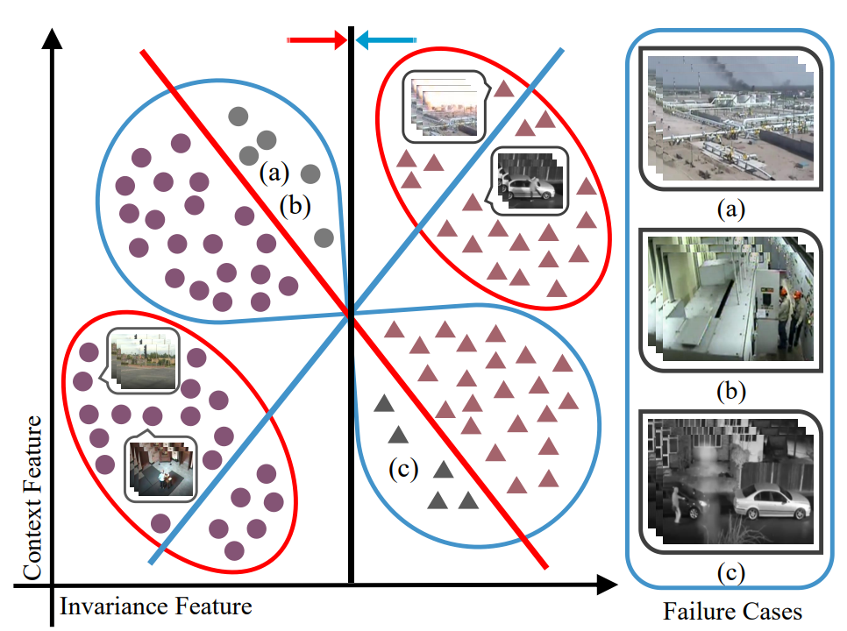
3. Conclusion
Red circle: Confident Set
Blue circle: Ambiguous Set
● : Normal sample
▲ : Abnormal sample
Gray instances : Failure cases
Red line : The classifier trained under MIL
Blue line : Ambiguous snippets clustering
Black line : The invariant classifier

Slide 12
3. Conclusion
Shows better result than current state-of-the-art methods on UCF-Crime and TAD
Models that improve on the biased approach of learning only normal/non-normal snippets
Remove context bias by separating unsupervised clusters from ambiguous snippets
The method of unsupervised clusters in ambiguous snippets might be used for various tasks.

Slide 13
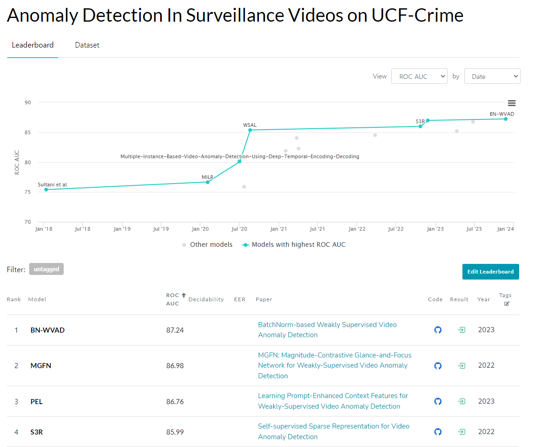
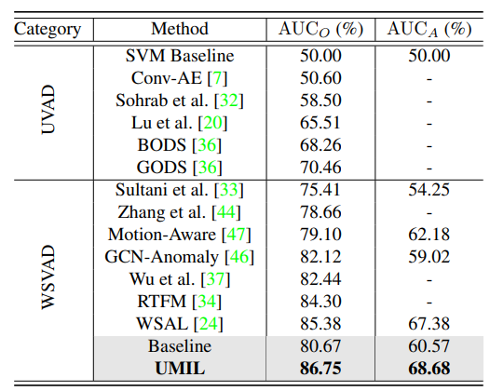
3. Conclusion

Slide 14
Thank you

